Slide 1

Use and abuse of Pronouns

Slide 2

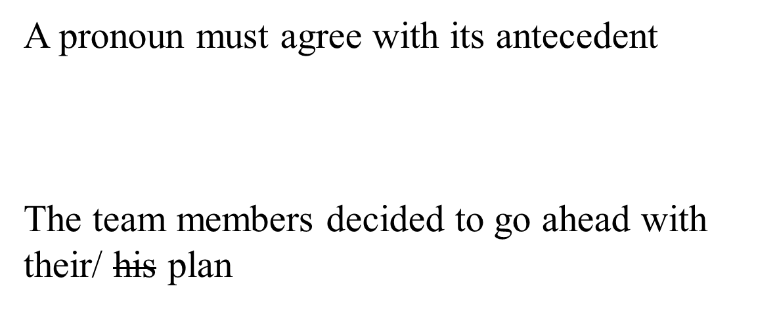

Slide 3
Its and It’s…
It’s [with an apostrophe] means it is or it has.
Its [without an apostrophe] means belonging to it—for example, its contents, its pages, its long claws, etc.
Possessive pronouns—unlike possessive nouns—do not need an apostrophe with the final s.

Slide 4

When each or every precedes two [or more] singular things joined by and, a singular antecedent is formed.
Each new song and dress has its impact on the youth
Department of Humanities & Management

Slide 5

In this situation, no matter how many singular nouns you join with and, the antecedent is still singular
Each moment, action, circumstance, opportunity, phenomenon and incident has its role in the larger scheme of things.
Department of Humanities & Management

Slide 6

Use caution with these three correlative conjunctions: either … or, neither … nor, and not only … but also.
Of the two antecedents in the sentence, the pronoun must agree with the closer one.
Not only Sonia but also the Guptas brought their famous collection to the party.
Not only the Guptas but also Sonia brought her famous collection to the party.
Department of Humanities & Management

Slide 7

Indefinite pronouns cause the biggest headaches for pronoun agreement.

Slide 8

Rule 4 : These indefinite pronouns are always singular [even when they seem plural].
Each, either, neither
Anyone, anybody, anything
Everyone, everybody, everything
No one, nobody, nothing
Someone, somebody, something

Slide 9
Neither of my two brothers show much sense when they speak in public.
This sentence might sound right, but it is completely wrong!
Neither of my two brothers shows much sense when he speaks in public.
Department of Humanities & Management

Slide 10

A writer who begins with he or she or him or her will need to be consistent. But look what happens . . .

Slide 11
Wanda Wrighter
Professor Pennington
ENC 1101
May 17, 2011
Student Success
If a student wants to improve his or her grades, he or she should walk himself or herself over to the tutoring center. There, he or she can request a tutor to help him or her with his or her homework. This preparation for his or her class will ensure that he or she is ready when taking his or her quizzes and exams. In addition, the tutor might have old work to share. This way, the student can find out himself/herself what to expect on the assignments for a specific instructor that might change his/her assignments rarely. Thus, the one thing that will insure the success of a student is that he or she gets a tutor to help him or her.

